Slide 1
Data Structures Basics
AI2C Tech Intro

Slide 2
Function arguments

Slide 3
Objectives
Know when and how to apply nested lists
Implement and discuss some basic list manipulation techniques

Slide 4
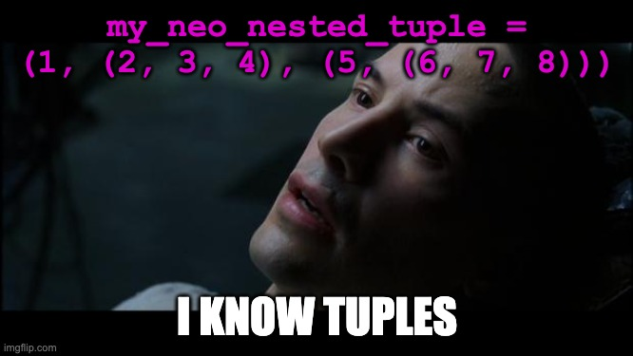
Python review

Slide 5
Mutable vs Immutable

Slide 6
Initializing Tuples and Lists

Slide 7
Copying Tuples and Lists

Slide 8
Hands-On #1
Mutable and immutable structures
Working with tuples and lists

Slide 9
Nested lists

Slide 10
Hands-On #2
Work with nested lists to represent arrays

Slide 11
Questions?

